Slide 1
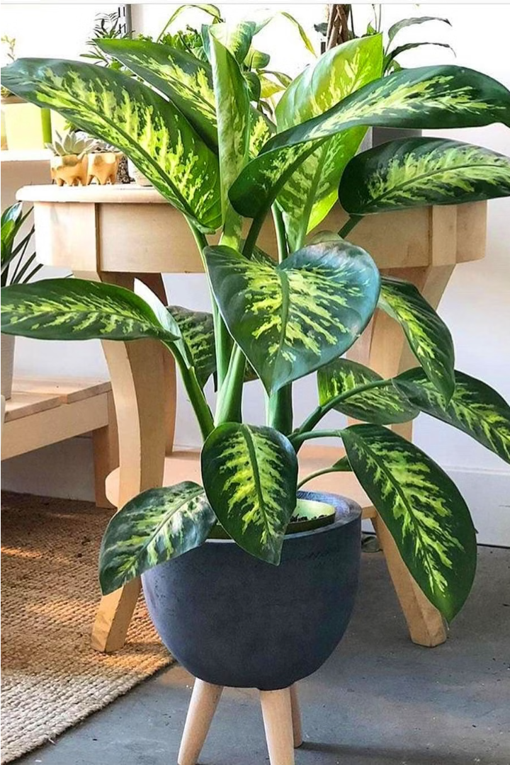
Introduction to Plantcare Remainder App
The Plantcare Remainder App is a user-friendly digital tool designed to help plant enthusiasts effortlessly manage and care for their indoor greenery. With its intuitive interface and smart features, the app simplifies the process of keeping your plants healthy and thriving.
By: Nivethitha.R
Shalini.S
Trisha Shiny.J
Vigneswari.D
Akshaya.R

Slide 2
Key Features
1
Plant Profiles
2
Watering Reminders
Detailed information on plant species, care requirements, and best practices.
Personalized alerts to ensure your plants receive the right amount of hydration.
3
Fertilizer Schedules
4
Tracking and Insights
Customized feeding plans to support optimal plant growth and development.
Logging and monitoring tools to help you understand your plant's needs.

Slide 3
User Interface Design
Clean and Intuitive
Visually Appealing
Responsive and Adaptive
The app's user interface is designed with simplicity and ease of use in mind, making it accessible to both novice and experienced plant owners.
Vibrant colors, high-quality images, and a modern aesthetic create an engaging and visually captivating experience.
The app seamlessly adapts to different screen sizes and device orientations, ensuring a consistent and optimized user experience.

Slide 4
Onboarding and Signup Process
1
Easy Setup
The signup process is straightforward, requiring only basic user information and preferences to get started.
2
Plant Library
Users can build their personal plant library by adding details about their indoor greenery.
3
Personalized Recommendations
The app offers tailored plant care suggestions based on user inputs and environmental factors.

Slide 5
Plant Care Tracking and Reminders
Watering Schedules
Fertilization Logs
The app tracks watering history and provides timely reminders to ensure your plants receive the proper hydration.
Monitor and schedule fertilizer applications to support the overall health and growth of your plants.
Pruning and Maintenance
Customizable Alerts
Receive guidance on when to prune, repot, or perform other maintenance tasks for each plant in your collection.
Users can customize the frequency and timing of notifications to suit their individual plant care preferences.

Slide 6




Personalization and Customization
Plant Profiles
Preferences
Scheduling
Reminders
Personalize each plant's details, including species, location, and care requirements.
Customize app settings, notifications, and other preferences to fit your individual needs.
Set personalized schedules for watering, fertilizing, and other plant care activities.
Receive timely alerts to ensure you never forget important plant care tasks.

Slide 7
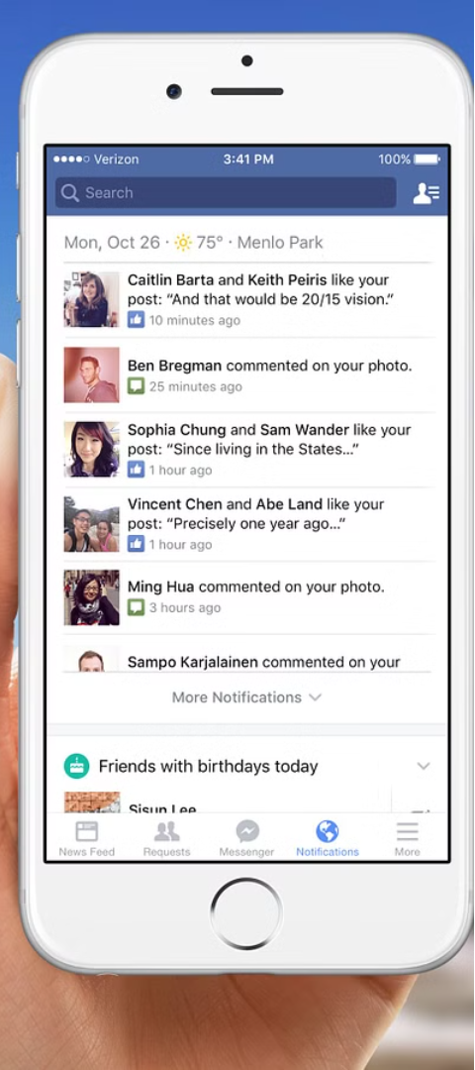



Notifications and Alerts
Watering Alerts
Receive notifications when it's time to water your plants, helping you maintain the optimal moisture levels.
Fertilizer Reminders
Get timely alerts to apply fertilizer, ensuring your plants receive the necessary nutrients for growth.
Maintenance Prompts
The app will notify you when it's time to prune, repot, or perform other care tasks for your plants.

Slide 8

Conclusion and Next Steps
The Plantcare Remainder App is a comprehensive solution for plant enthusiasts, simplifying the management of indoor greenery and helping users maintain healthy, thriving plants. As the app continues to evolve, the development team plans to introduce new features, such as plant health diagnostics and social sharing capabilities, to enhance the user experience.

